Slide 1

NAVIGATION AND WEATHER SENSING
IN BLIND STICK USING IOMT
TEAM MEMBERS:
NARESH RAVI THAIYALNAYAKI [210421121032]
MANOJ T [210421121027]
BHARATH G [210421121007]

Slide 2
PROBLEM STATEMENT
India is now home to the world’s largest number of blind people. Of the 37 million people across the globe who are blind, over 15 million are from India. There has been many efforts but even now, it is not easy for blind people to independently move. At present several devices are available for providing guidance to a remote location but these are either expensive or not easy to use.
Visually impaired persons find themselves challenging to travel out independently. Millions of visually impaired or blind people during this world are always in need of helping hands.
While walking into an unfamiliar place or in an crowed area with just a blind stick cannot seek them an good comfortable to walk through and the Person has to completely depend on other people to reach destination, this restricts their mobility.

Slide 3
LITERATURE REVIEW
Sl. No | Title of the Paper | Authors | Name of the Journal, Year, Volume, Issue | Observation
1 | Ultrasonic Blind Stick For Completely Blind People To Avoid Any Kind Of Obstacles | Arnesh Sen, Kaustabh Sen and Jayoti Das | IEEE Sensors, Year-2018, Issue-2 | Observed about the operation on avoiding
2 | Voice Recognition and Voice Navigation for Blind using GPS | Manisha Bansode, Shivani Jadhav and Angela Kashyap | International Journal of Innovative Research In Electrical, Electronics, Instrumentation and Control Engineering, Year-April 2015, Vol-3, Issue-4 | Observed about the Voice Recognition and Navigation module utilization and output
3 | Review on Smart Stick for Blind People | Komal Lende, Anuja Muntode, Sanjivani Shelar, Shubhangi Adhav | International Journal of Creative Research Thoughts(IJCRT), Year- March 2021,Vol 3, Issue 3 | A study on to style a sensible walking stick

Slide 4
EXISTING SYSTEM
Devices or supports like white cane for helping them to detect the obstacles and travel to places.
Pet dogs.
Smart devices like vision a torch for blinds.
Guide Cane and Smart vision which use ultrasonic sensors or laser sensors to detect obstacles in front of the blind by transmitting the wave and reception of reflected waves. It produces either an audio or vibration in response to detected obstacles to warn blind.
IoT Systems to monitor and save the Blind travelling data's via Cloud.

Slide 5
PROPOSED SYSTEM
Navigation Enhancement:
The proposed system will provide accurate and real-time navigation assistance for caretaker.
integration of sensors to detect obstacles and create safer paths.
Weather Sensing Integration:
The system will incorporate weather sensors for real-time weather updates.
Mention how users will receive weather alerts and warnings.
User-Friendly Interface:
The design considerations for an intuitive interface accessible to the visually impaired.
Mention voice commands, tactile feedback, or auditory cues.
Potential Benefits:
Highlighting the potential beneifts including real-time weather awareness, and enhanced user experience.
.

Slide 6
WORKING
Project Objective:
To design an IoT-based blind stick that enhances navigation and provides real-time weather updates to the blind people according to their comfortablity.
Navigation Enhancement:
the system will provide precise navigation cooridnates to the caretaker with ease assistance.
the utilization of sensors for obstacle detection and path guidance.
Weather Sensing Integration:
weather sensors will be integrated to provide real-time weather updates and visually impaired users will receive weather alerts and warnings.
Remote Integration:
The blind stick will be connected with a RF .
the interaction between the user and the IoT-based system.
Energy Efficiency:
The energy-efficient design to maximize battery life.
Power consumption will be optimized without compromising performance.

Slide 7
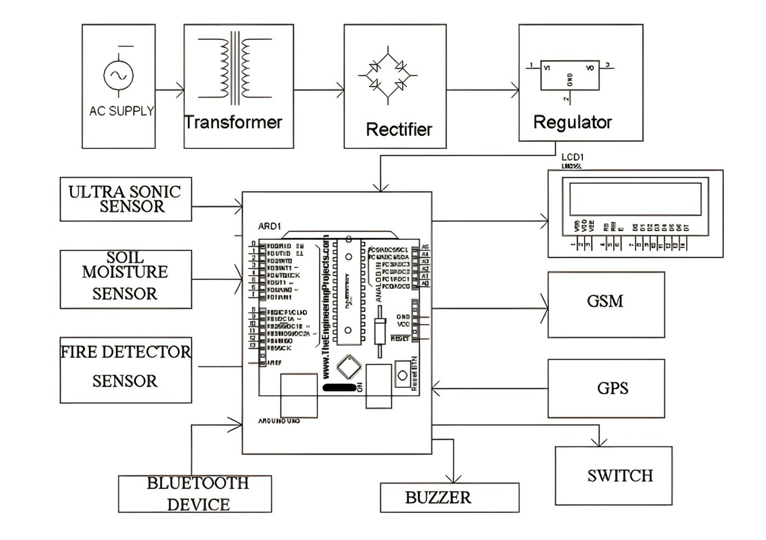
CIRCUIT DIAGRAM

Slide 8


